Slide 1


Tools for Developers
Integrated Development Environments, Source Control Repositories, Automated Testing Tools, Bug Tracking, Code Analysis Tools, Build Tools, Project Hosting Sites, Deployment in the Cloud
Svetlin Nakov
www.nakov.com
Telerik Software Academy
academy.telerik.com

Slide 2

Table of Contents
Integrated Development Environments (IDEs)
Source Control Systems
Code Generation Tools
Logging Tools
Unit Testing Tools
Bug Tracking / Issue Tracking Systems
Code Analysis Tools
Code Decompilation Tools

Slide 3

Table of Contents (2)
Code Obfuscators
Code Profilers
Refactoring Tools
Automated Build Tools
Continuous Integration Tools
Documentation Generators
Project Hosting and Team Collaboration Sites
Deployment in the Public Clouds

Slide 4



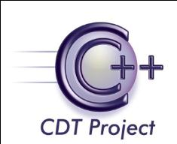
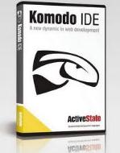


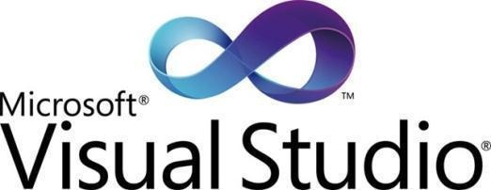


Integrated Development Environments (IDEs)
Visual Studio, Eclipse, IntelliJ IDEA, Netbeans, JDeveloper, Code::Blocks, Bloodshed Dev-C++

Slide 5
Visual Studio
Visual Studio is official .NET development tool from Microsoft
Multiple languages: C#, VB.NET, C++, …
Multiple technologies and platforms: ASP.NET, WPF, Silverlight, WWF, WCF, Windows Mobile
Very powerful and feature rich
Write, compile, model, design GUI, forms, data, build, execute, debug, test, deploy, refactor, …
Commercial product, has free editions

Slide 6
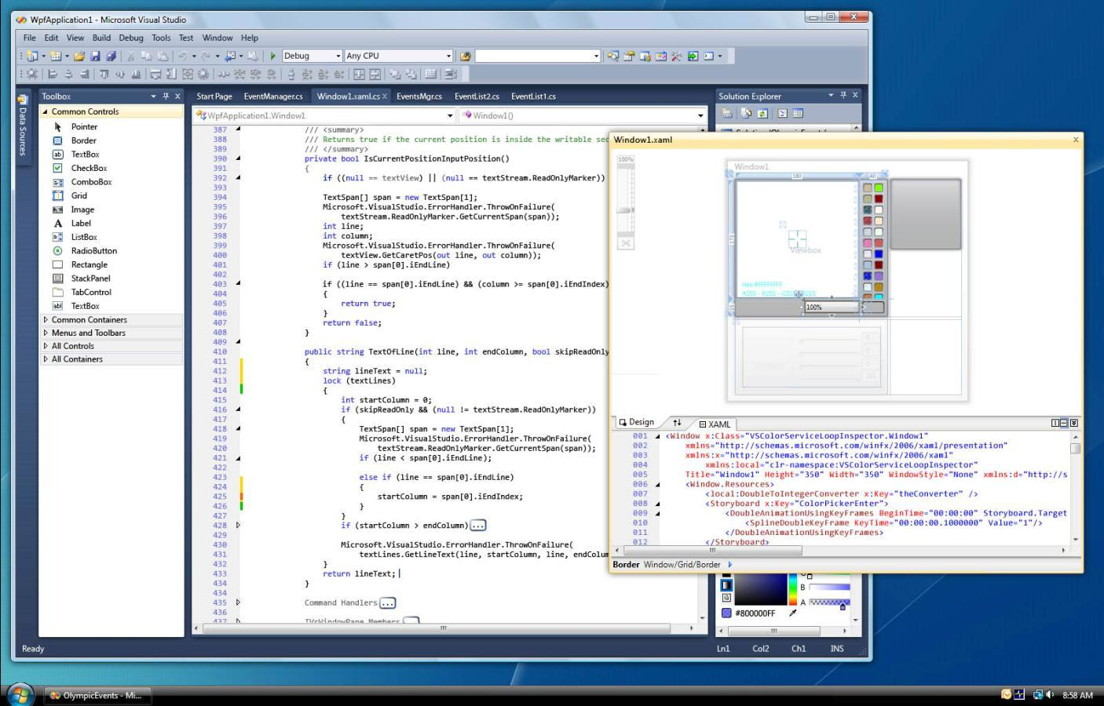
Visual Studio – Screenshot

Slide 7
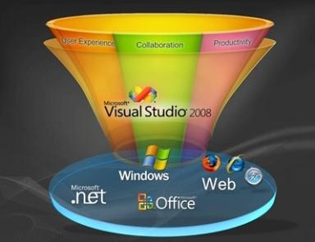



Visual Studio
Live Demo

Slide 8
Eclipse
Eclipse is the #1 Java IDE
Supports multiple languages and platforms: Java, Java EE, C++, PHP, Python, Ruby, mobile development, embedded development, …
Very powerful and feature rich
Write, compile, build, execute, debug, test, deploy, refactor, …
Thousands of plug-ins
Free, open-source product, very big community

Slide 9
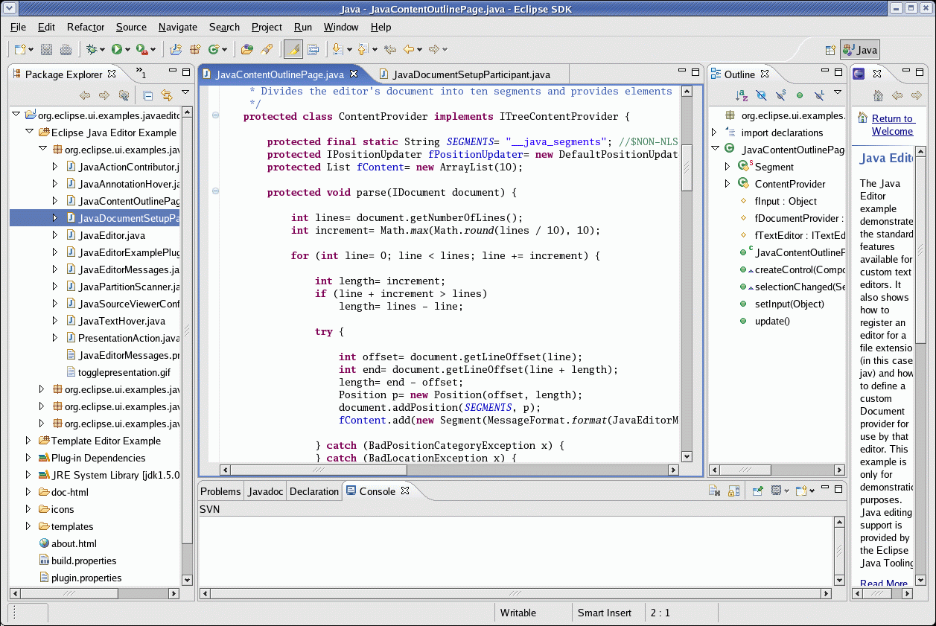
Eclipse – Screenshot

Slide 10
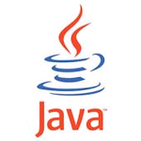

Other IDEs
Other Java IDEs
Netbeans
Supports latest Java technologies
Nice GUI designer for Swing and JSF
IntelliJ IDEA – very powerful refactoring
JDeveloper – feature rich, supports UML
Other C++ IDEs
Code::Blocks
Bloodshed Dev-C++

Slide 11





Source Control Systems
Subversion (SVN), Team Foundation Server (TFS), CVS, Git, Mercurial, Perforce, …

Slide 12
What is Source Control System?
Source control systems (version control systems, source control repositories)
Hold the source code and project assets during the development process
Allow simultaneous changes in the source code and conflict resolution
Keep version history of the project assets
Two versioning models:
Lock-Modify-Unlock and Copy-Modify-Merge

Slide 13
Lock-Modify-Unlock Model
The lock-modify-unlock model needs locking files before modification
One file is modified by at most one person in any given moment
No conflicts, no need of merge
Suitable for small teams
When changes almost don't need concurrency
Basic commands: check out, check-in
Implemented in: Visual SourceSafe, (TFS, SVN)

Slide 14
Copy-Modify-Merge Model
Copy-modify-merge model does not hold locks during the source code modification
The same file could be simultaneously edited by multiple developers
Sometimes requires conflict resolution
Suitable for large teams and projects
High concurrency of source code modifications
Basic commands: update, commit
Implemented in: SVN, CVS, Git, Mercurial, TFS

Slide 15
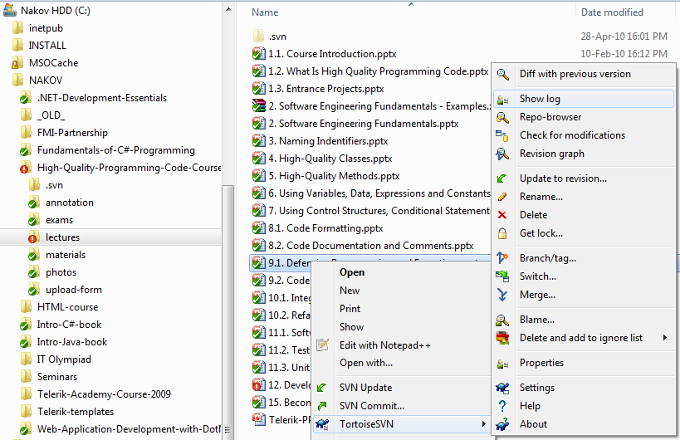
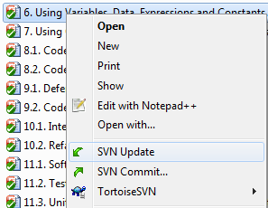
Subversion (SVN)
Subversion (SVN)
Popular and well established system
Free, open-source, very large community
TortoiseSVN – the most popular client

Slide 16
Subversion (SVN) (2)
Subversion (SVN)
Official web site:
http://subversion.tigris.org/
Runs on UNIX, Linux, Windows
Console client
svn
GUI client
TortoiseSVN – http://tortoisesvn.tigris.org/

Slide 17
Subversion Features
Versioning of the directory structure
Complete change log
Deletion of files and directories
Renaming of files and directories
Saving of files or directories
Can work on it’s own or integrated with Apache as a module
Works effectively with tags and branching

Slide 18
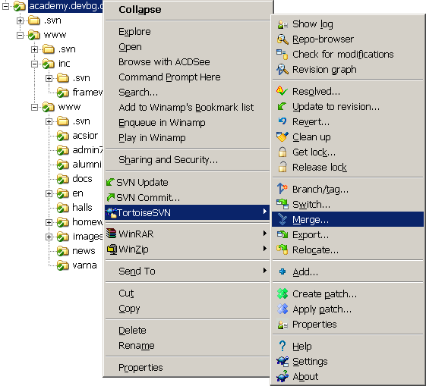
TortoiseSVN
TortoiseSVN
Open source GUI client for Subversion
Integrated in Windows Explorer
http://tortoisesvn.tigris.org/

Slide 19
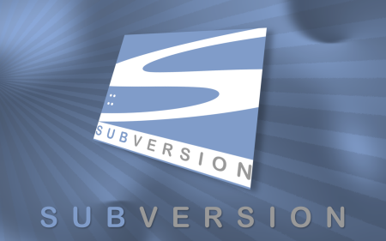
Subversion
Live Demo

Slide 20
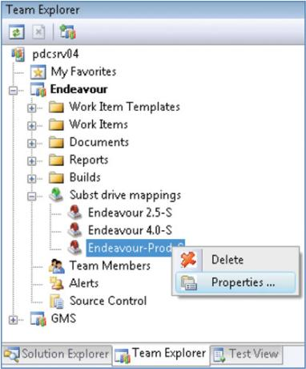
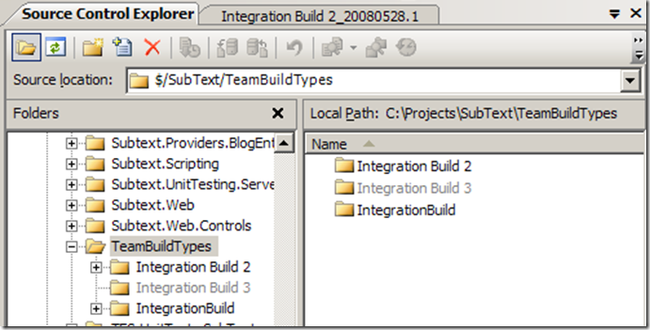
Team Foundation Server
Microsoft Team Foundation Server (TFS)
Works best with Visual Studio
Many problems outside of it
Commercial license

Slide 21
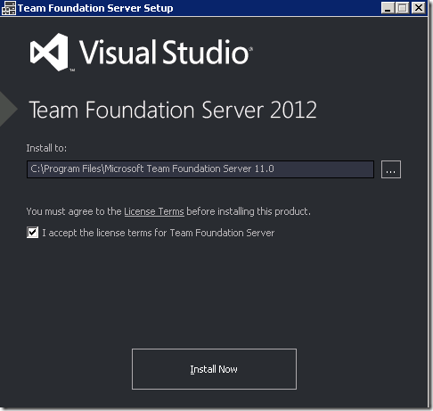
TFS
Live Demo

Slide 22
Other Source Control Systems
CVS
Was extremely popular in the past
Now it is obsolete
Open source, mostly used in UNIX / Linux
Git and Mercurial
Fast, distributed, open source
Perforce
Very powerful and scalable (pentabytes of code)
Commercial product (used by SAP)

Slide 23
SCM and ALM Systems
Software Configuration Management (SCM systems (e.g. Rational ClearCase, StarTeam)
Change management for requirements, documents, source code, etc.
Tools, policies, workflow, etc.
Application Lifecycle Management (ALM) systems (e.g. VSTS + TFS, StarTeam, Polarion)
Covers the entire development process
Requirements, planning, project management, architecture, build, QA, test, integration, etc.

Slide 24
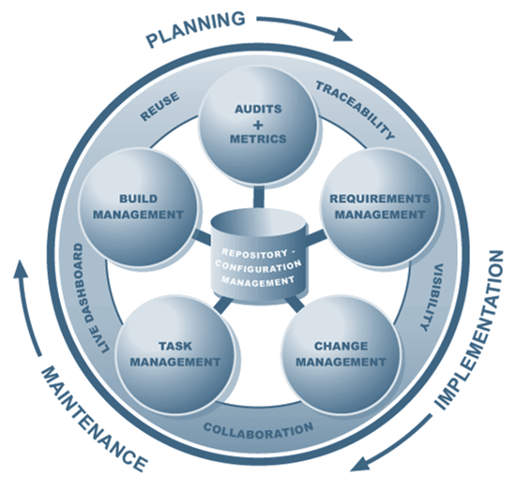
Application Lifecycle Management

Slide 25

Code Generation Tools
Visual Studio T4 Engine, CodeSmith, AndroMDA

Slide 26
Code Generators – Concepts
Source code generation
Template based
Build data access layer by given database schema
E.g. Visual Studio Data Designer for LINQ-to-SQL
Build Web application by database schema
E.g. Django (Python based Web application platform)
Model based
Build entire application by high-level model

Slide 27
Code Generation Tools
Microsoft T4 Engine, CodeSmith
Template based code generators
Can generate classes, Web pages and other project assets by set of templates
E.g. data access layer based on database schema
AndroMDA
Application generator framework
Transforms UML models to Java EE applications based on Spring, Hibernate and JSF

Slide 28
Microsoft T4 Template Engine
Visual Studio T4 Engine
T4 == Text Template Transformation Toolkit
Integral part of Visual Studio
ASP.NET-like syntax
T4 templates consist of:
Processing directives (e.g. include template)
Text blocks (static text)
Code blocks (in C#, VB.NET)
Compiled to C# and then to .NET assemblies

Slide 29
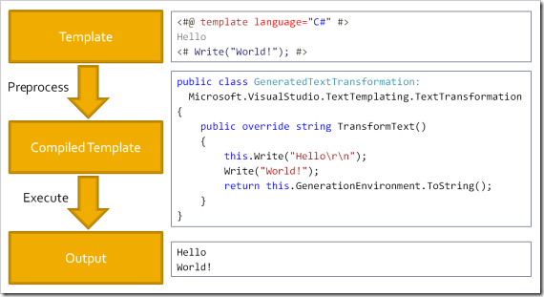
T4 Template Engine – Architecture

Slide 30
Visual Studio T4 Example
<#@ template debug="false" hostspecific="false" language="C#" #>
<#@ assembly name="System.Core" #>
<#@ import namespace="System.Text" #>
<#@ import namespace="System.Collections.Generic" #>
<#@ output extension=".cs" #>
<# for(int i = 0; i < 3; i++) { #>
public int Item<#=i#> { get; set; }
<# } #>
public int Item0 { get; set; }
public int Item1 { get; set; }
public int Item2 { get; set; }

Slide 31
Visual Studio T4 Example (2)
<#@ template language="C#" hostspecific="true" #>
<#@ output extension=".xml" #>
<#@ import namespace="System.IO" #>
<#@ import namespace="Microsoft.VisualStudio.TextTemplating" #>
<?xml version="1.0" ?>
<project>
<# string currentDir = this.Host.ResolvePath(".");
foreach (string dir in Directory.GetFiles(currentDir))
{
FileInfo fileInfo = new FileInfo(dir);
#>
<file><#= fileInfo.Name #></file>
<# } #>
</project>

Slide 32

Visual Studio T4 Template Engine
Live Demo

Slide 33





Logging Tools
Log4J, Log4Net

Slide 34
Logging
Logging is chronological and systematic record of data processing events in a program
E.g. the Windows Event Log
Logs can be saved to a persistent medium to be studied at a later time
Use logging in the development phase:
Logging can help you debug the code
Use logging in the production environment:
Helps you troubleshoot problems

Slide 35
Log4J / Log4Net
Log4J / Log4Net are a popular logging frameworks for Java / .NET
Designed to be reliable, fast and extensible
Simple to understand and to use API
Allows the developer to control which log statements are output with arbitrary granularity
Fully configurable at runtime using external configuration files

Slide 36
Log4j / Log4Net Architecture
Log4Net has three main components: loggers, appenders and layouts
Loggers
Channels for printing logging information
Appenders
Output destinations (e.g. XML file, database, …)
Layouts
Formats that appenders use to write their output

Slide 37
Hello Log4Net – Example
class Log4NetExample
{
private static readonly ILog log =
LogManager.GetLogger(typeof(Log4NetExample));
static void Main()
{
BasicConfigurator.Configure();
log.Debug("Debug msg");
log.Error("Error msg");
}
}
Output from Log4NetExample
2010-12-16 23:25:08 DEBUG Log4NetExample – Debug msg
2010-12-16 23:25:08 ERROR Log4NetExample – Error msg
…

Slide 38
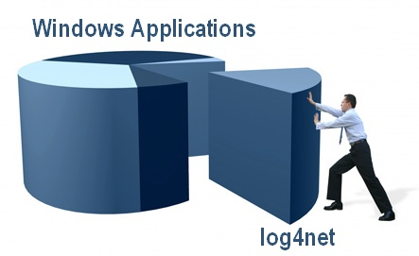
Log4Net
Live Demo

Slide 39




Unit Testing Tools
JUnit, NUnit, CppUnit, TestNG, JsUnit, …

Slide 40
Unit Testing
Unit test is a program that tests pieces of code
Test a single method, class or component
Implement a common use case scenario
Confirm that the code works as expected
Or signal that the code is broken
Unit tests should have high code coverage, e.g. 70-80%
Executed in the continuous integration process
Unit tests dramatically decrease the number of defects in the code

Slide 41

Unit Test – Example
int sum(int[] array) {
int sum = 0;
for (int i=0; i<array.length; i++)
sum += array[i];
return sum;
}
void testSum() {
if (sum(new int[]{1,2}) != 3)
throw new TestFailedException("1+2 != 3");
if (sum(new int[]{-2}) != -2)
throw new TestFailedException("-2 != -2");
if (sum(new int[]{}) != 0)
throw new TestFailedException("0 != 0");
}

Slide 42
Unit Testing Frameworks / Tools
Unit testing frameworks
Simplify design, implementation and execution of unit tests
Popular unit testing frameworks
JUnit, TestNG – classical unit testing frameworks for Java
Visual Studio Team Test (VSTT), NUnit, MbUnit – for .NET development
cppUnit, UnitTest++ – for C++ developers
jsUnit – for JavaScript

Slide 43
Code Coverage & Mocking Tools
Code coverage tools
Code coverage tools check what portion of the source code is covered by the unit tests
CodeCover for Eclipse – for Java
Visual Studio Team Suite – for C#
CoverageMeter – for C++
Mocking tools
Allow testing functionality that is still not implemented9, e.g. through its interface
Moq, TypeMock, Rhino Mock, JustMock

Slide 44
Test Automation
Test automation
Replaces manual tests (performed by people) with automated tests (performed by script)
Automatically run test scenarios and compare the actual outcomes to predicted outcomes
Automated testing tools
Record and replay test scenarios
Automated testing frameworks
Allow programmatically simulate user activity

Slide 45


Unit Testing and Code Coverage with VSTT
Live Demo

Slide 46


Bug Tracking / Issue Tracking Systems
TRAC, Bugzilla, JIRA, TFS, SourceForge, Google Code, CodePlex, Project Locker

Slide 47
Bug Tracking Systems
Bug tracking / issue tracking systems
Track bugs / issues related to software development, called tickets
Tickets consist of:
Category: bug / feature request / task
State: new → assigned → fixed → closed
Priority: critical / high / low / etc.
Owner / responsible person
Summary, description, attachments

Slide 48


Code Analysis Tools
FxCop, StyleCop, Checkstyle, devAdvantage, FindBugs, BoundsChecker, …

Slide 49
Code Analysis Tools
Code analysis tools
Analyze the source code for bad coding style / unwanted coding practices
Static analysis
Examine the source code at compile-time
Could work with the source code or with the compiled assemblies / JAR archives
Dynamic analysis
Analyses the code at runtime (usually done by code instrumentation)

Slide 50


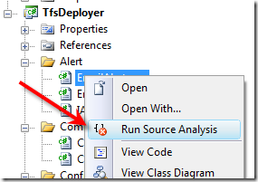
StyleCop
Live Demo

Slide 51
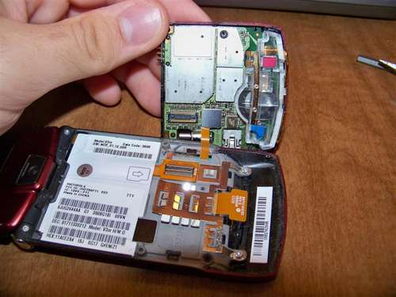

Code Decompilation Tools
JustDecompile, IL Spy

Slide 52
Code Decomplation
Code decompilator / code disassembler
Reconstructs the source code (to some extent) from the compiled code
.NET assembly → C# / VB.NET source code
JAR archive / .class file → Java source code
.EXE file → C / C++ / Assembler code
Reconstructed code
Is not always 100% compilable
Loses private identifier names and comments

Slide 53
Code Decomplation Tools
Code decompilers
.NET
JustDecompile – free, powerful .NET decompiler
ILSpy – powerful, great usability, free
ILDASM – part of .NET SDK, decompiles to IL code
Java
DJ Java Decompiler
JD (JD-Core / JD-GUI / JD-Eclipse)
.EXE file
Boomerang Decompiler → outputs C source code
IDA Pro – powerful disassembler / debugger
OllyDbg, W32DASM, etc.

Slide 54
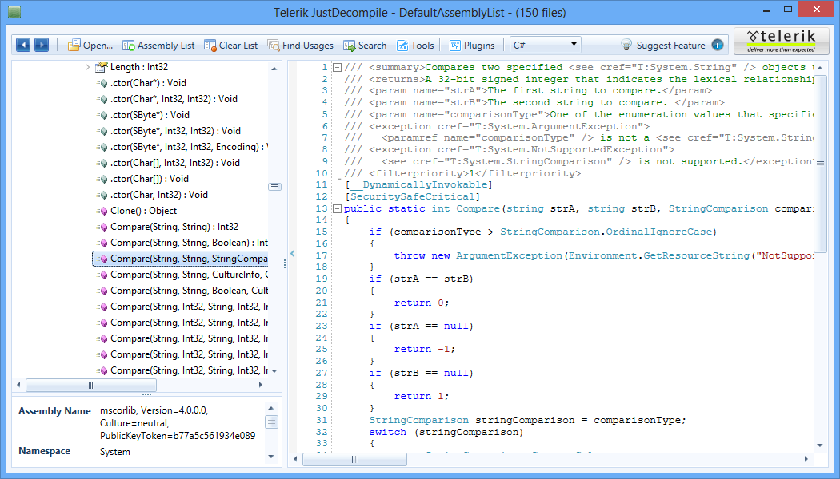
JustDecompile

Slide 55



JustDecompile & ILSpy
Live Demo

Slide 56



Code Obfuscators
Making Reverse Engineering Difficult

Slide 57
Code Obfuscation
Code obfuscation
Transform the source code or compiled .NET / Java code into a difficult to understand form
Obfuscated code has the same behavior
Sometimes is a bit slower due to changes and additions in the control logic
Obfuscated code is the opposite of the high-quality code
Obfuscation is a form of security through obscurity

Slide 58
Code Obfuscation Techniques
Rewrite for-loops as while-loops followed by a series of cascading if-else statements
Change iteration into recursion
Obfuscate programming constructs (e.g. turn if-else statements into ?: operators)
Introduce meaningless identifier names
Remove intermediate variables and literals by repeating them as expressions in the code
Remove literals (e.g. 0 and 1) – use expressions
Randomize code formatting

Slide 59
Simple Obfuscation – Example
Original source code in C#
Obfuscated and decompiled
long first = 1
long second = 1;
for (int i = 3; i <= N; i++)
{
result = first + second;
first = second;
second = result;
}
return result;
long _ = 1L;
long __ = 1L;
for (int ___ = 3; ___ <= _____; ___++)
{
____ = _ + __;
_ = __;
__ = ____;
}
return ____;

Slide 60
Obfuscation Tools
.NET obfuscators
Eazfuscator.NET – free
{smartassembly} – commercial license, very powerful – assembly obfuscation + compression
Java obfuscators
ProGuard – free, open-source
yGuard – free, open source
C++ obfuscators
Stunnix C++ Obfuscator – commercial product

Slide 61

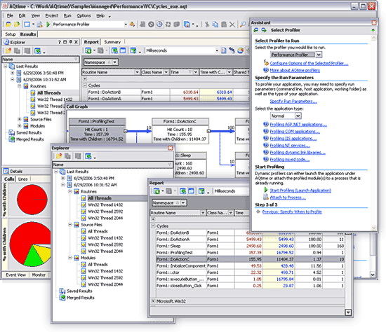
Code Profilers
ANTS Profiler for .NET, YourKit Profiler for .NET, Netbeans Profiler for Java, JProfiler, JProbe

Slide 62
Profilers
Profilers are tools for gathering performance data and finding performance bottlenecks
Implemented by code instrumentation or based on built-in platform debugging / profiling APIs
Gather statistics for method calls, uses of classes, objects, data, memory, threads, etc.
CPU profilers
Find performance bottlenecks
Memory profilers
Find memory allocation problems

Slide 63
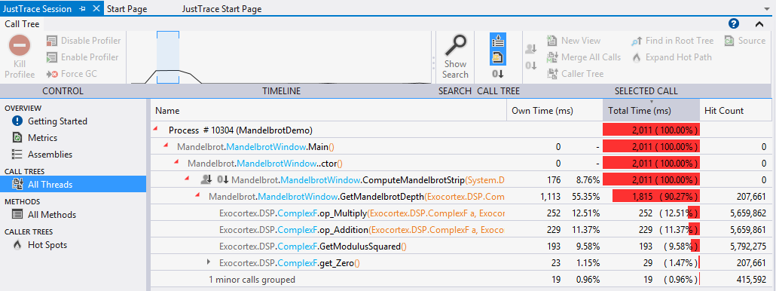
JustTrace Profiler
What is JustTrace?
Designed for code and memory profiling
Measures the frequency and duration of function calls
Collects information about memory usage

Slide 64

Refactoring Tools
JustCode, ReSharper, IntelliJ IDEA, Visual Studio, Eclipse, Netbeans, JDeveloper

Slide 65
Refactoring
Refactoring
Improving the design of the existing code without changing its behavior
Typical refactoring patterns
Rename variable / class / method / member
Extract method
Extract constant
Extract interface
Encapsulate field

Slide 66
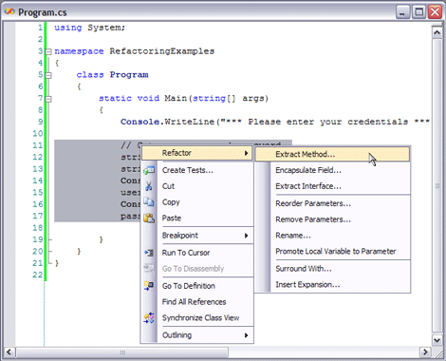
Refactoring in Visual Studio

Slide 67

Refactoring in Visual Studio with / without JustCode
Live Demo

Slide 68
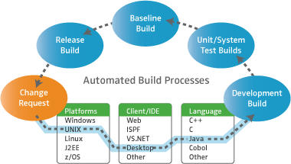
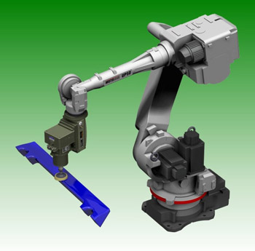
Automated Build Tools
CMake, Ant, Maven, MSBuild

Slide 69
Software Builds
What means to build software?
The process of compiling and assembling the system's modules to obtain the final product
Build activities can also include:
Getting the latest version from the source control repository
Linking external resources
Executing unit tests
Creating installation packages

Slide 70
Sample MS Build File
.csproj file is actually a MS Build file
<Project xmlns="http://schemas.microsoft.com/developer/msbuild/2003">
<PropertyGroup>
<AssemblyName>MSBuildSample</AssemblyName>
<OutputPath>Bin\</OutputPath>
</PropertyGroup>
<ItemGroup>
<Compile Include="helloworld.cs" />
</ItemGroup>
<Target Name="Build">
<MakeDir Directories="$(OutputPath)" Condition="!Exists('$(OutputPath)')" />
<Csc Sources="@(Compile)" OutputAssembly="$(OutputPath)$(AssemblyName).exe" />
</Target>
</Project>

Slide 71

Continuous Integration Tools
CruiseControl, CruiseControl.NET, Hudson, Team Foundation Server

Slide 72
Continuous Integration (CI)
Continuous integration (CI)
Automating the build and integration process
Build the entire system each time any new code is checked in the source control repository
Run all the automated tests for each build
What does "continuous" mean?
Ideally – build it after every check-in
Practically – for larger systems, every 1-2 hours
Or at least a couple of times a day

Slide 73
Components of the CI System
Build server – separate machine (or pool)
Source control repository
Subversion, Team Foundation Server (TFS), etc.
Automated build system
Ant, NAnt, MSBuild, Cruise Control, TFS, etc.
Status indicators / notifications to make problems visible right away
Email notifications / tray build notify utilities
Public build status monitors

Slide 74
Continuous Integration Systems
CruiseControl
Very popular, powerful, open source CI tool
Extensible, plug-in based, large community
CruiseControl.NET
.NET cloning of CruiseControl
Hudson
Powerful Java based CI server, open source
Team Foundation Server (TFS)
TFS provides build-in continuous integration

Slide 75
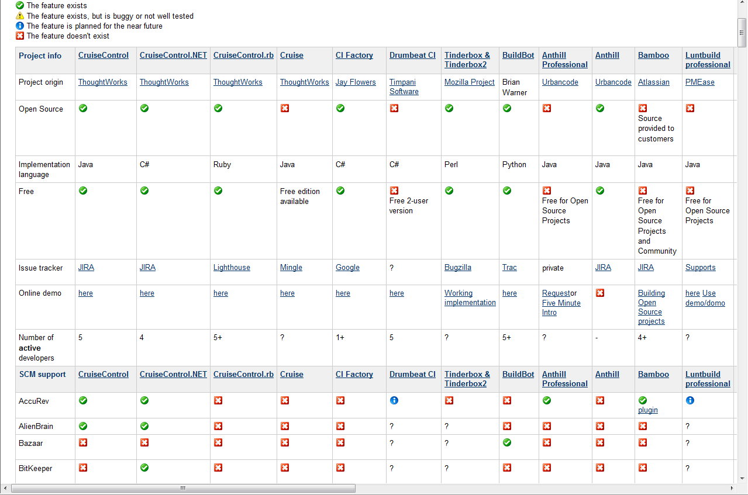
CI Systems Comparison Matrix
Continuous integration systems – comparison:
http://confluence.public.thoughtworks.org/display/CC/CI%2BFeature%2BMatrix

Slide 76

Continuous Integration with TFS
Live Demo

Slide 77

Documentation Generators
Javadoc, Sandcastle, Doxygen, JSDoc

Slide 78
Documentation Frameworks
The best source code documentation is the code itself
Special types of comments are used in many platforms
Used to document the code classes, methods, parameters, return types, exceptions, etc.
Javadoc comments in Java
XML documentation in .NET
Doxygen-style documentation for C, C++, PHP, Python, Java, C#, etc.

Slide 79
Documentation Generators
Javadoc
Transforms Javadoc comments used in Java into HTML documentation
Sandcastle
Transforms the XML comments used .NET into CHM, HTML, PDF and other formats
Doxygen
Transforms Doxygen comments into HTML
JSDoc
Javadoc cloning for JavaScript

Slide 80

Project Hosting and Team Collaboration Sites
SourceForge, Google Code, CodePlex, Project Locker

Slide 81
Project Hosting Sites
SourceForge – http://www.sourceforge.net
Source control (SVN, Git, …), web hosting, tracker, wiki, blog, mailing lists, file release, statistics, etc.
Free, all projects are public and open source
Google Code – http://code.google.com
Source control (SVN), file release, wiki, issue tracker
Very simple, basic functions only, not feature-rich
Free, all projects are public and open source
1-minute signup, without heavy approval process

Slide 82
Project Hosting Sites (2)
CodePlex – http://www.codeplex.com
Microsoft's open source projects site
Team Foundation Server (TFS) infrastructure
Source control (TFS), issue tracker, downloads, discussions, wiki, etc.
Free, all projects are public and open source
Project Locker – http://www.projectlocker.com
Source control (SVN), TRAC, CI system, wiki, etc.
Private projects (not open source)
Free and paid editions

Slide 83
Project Hosting Sites (3)
GitHub – https://github.com/
Web-based hosting service for software development projects
Uses the Git revision control system
Bitbucket – http://bitbucket.org
Source control (Mercurial), issue tracker, wiki, management tools
Private projects, free and paid editions
Others: Assembla, Unfuddle, XP-Dev, Beanstalk, etc.

Slide 84

GitHub
Live Demo

Slide 85



Project Deployment in the Public Clouds
Public
Clouds
AWS, GAE, Azure, AppHarbor, PHPFog, …

Slide 86

What is Cloud?
Cloud ≈ multiple hardware machines combine computing power and resources
Share them between multiple applications
To save costs and use resources more efficiently
Public clouds
Provide computing resources on demand
Publicly in Internet
Paid or free of charge (to some limit)
Azure, Amazon AWS, Google App Engine, AppHarbor, Rackspace, Heroku, …

Slide 87

AppHarbor
AppHarbor – cloud platform for .NET apps
Supports a classical .NET development stack
C#, .NET Framework, ASP.NET (Web Forms and MVC), WCF, WWF, ADO.NET Entity Framework, …
Deployment through Git / SVN / TFS
Automated build process (compilation + unit tests)
Build-in load balancing
Rich set of add-on services

Slide 88
AppHarbor .NET Cloud
Live Demo

Slide 89
Tools for Developers
http://academy.telerik.com

Slide 90
Homework
Research and use the following tools on one of your projects and provide some output or screenshots for each tool to prove that you actually used the tools
One source control system (TFS, SVN or Git)
log4net
StyleCop or JustCode
JustDecompile
Sandcastle or Doxygen
Some obfuscation tool of your choice
Write a simple T4 template of your choice
Upload anonymously a project to a project hosting site (GitHub, Google Code, etc.) and provide a public link to the project. The project can be from your homework.

Slide 91
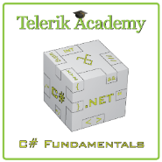



Free Trainings @ Telerik Academy
C# Programming @ Telerik Academy
csharpfundamentals.telerik.com
Telerik Software Academy
academy.telerik.com
Telerik Academy @ Facebook
facebook.com/TelerikAcademy
Telerik Software Academy Forums
forums.academy.telerik.com

